Slide 1
Fick's second law of Diffusion
Numerical Methods of Chemical Engineering (CHE F242)
Group-10
Apurva Rana Arsh Kumbhat Hitika Gupta Sunidhi Garg
2018B2A10725P 2019A1PS0444P 2018B3A10777P 2018B4A10864P

Slide 2

Problem Statement
Obtain the concentration profile of Carbon which diffuses into a 1-D steel rod. Initial Concentration of the carbon at t = 0 s is 0.1 wt%. The total time taken for diffusion to occur across a 5 cm length section of a rod is 600 minutes. The diffusivity of the carbon particles is 3.4 * ${10}^{−9}$ $m^{2}$/s. The final concentration of carbon at x = 5 cm is 0.05 wt% and at x = 0 the concentration is 1 wt%.

Slide 3
CASE HARDENING
It is a technique by which both surface hardness and fatigue life are enhanced for steel alloys.
It is accomplished by exposing the component to a carbonaceous or nitrogenous atmosphere at an elevated temperature.
A carbon- or nitrogen-rich outer surface layer (or “case”) is introduced by atomic diffusion from the gaseous phase. The case is normally on the order of 1 mm deep and is harder than the inner core of material.

Slide 4

Approach
The problem statement is based on Fick’s Second Law. So, the general diffusion equation for one-dimensional analysis under non-steady state condition is given by:
$$\frac{∂C}{∂t}=D\frac{∂^{2}C}{∂x^{2}}$$
Such Partial Differential Equations which are time variable with one spatial dimension are categorized as Parabolic equations.
Parabolic Partial Differential Equations can be solved numerically, by the following methods:
1. Explicit Method
2. Implicit Method
3. Crank Nicolson Method

Slide 5


Explicit Method
We have used three methods to solve our problem and the first one i.e., explicit method is given below:
We know,
D$\frac{{\text{∂}}^{2}C}{\text{∂}x^{2}}=\frac{\text{∂}C}{\text{∂}t}$
Using finite difference approximation we have,
$\frac{{\text{∂}}^{2}C}{\text{∂}x^{2}}$= $\frac{C_{i+1 }^{l}− 2C_{i}^{l} +{ C}_{i−1}^{l}}{{\text{(}Δx)}^{2}}$ & $\frac{\text{∂}C}{\text{∂}t}=\frac{C_{i}^{l+1}−C_{i}^{l} }{Δt}$
Finally, we get the equation:
C_{i}^{l+1} = $C_{i}^{l}$ + λ ($C_{i+1}^{l}$-2$C_{i}^{l}$ +$C_{i−1}^{l})$
where, λ= D $\frac{\text{Δt}}{{\text{(}\text{Δx}\text{)}}^{2}}$

Slide 6

Implicit Method
The second method used is implicit method as given below:
We know,
D $\frac{{\text{∂}}^{2}C}{\text{∂}x^{2}}=\frac{\text{∂}C}{\text{∂}t}$
Using finite difference approximation we have,
$\frac{{\text{∂}}^{2}C}{\text{∂}x^{2}}$= $\frac{{−C}_{i+1 }^{l+1} + 2C_{i}^{l+1} −{ C}_{i−1}^{l+1}}{{\text{(}Δx)}^{2}}$ & $\frac{\text{∂}C}{\text{∂}t}=\frac{C_{i}^{l+1}−C_{i}^{l} }{Δt}$
The final equation we get:
$C_{i}^{l}$ = - λ $C_{i−1}^{l+1}$+(1+2 λ)$C_{i}^{l+1}$- λ $C_{i+1}^{l+1}$
where, λ= D $\frac{\text{Δt}}{{\text{(}\text{Δx}\text{)}}^{2}}$
These equations need to be simultaneously solved in order to obtain the solution.

Slide 7
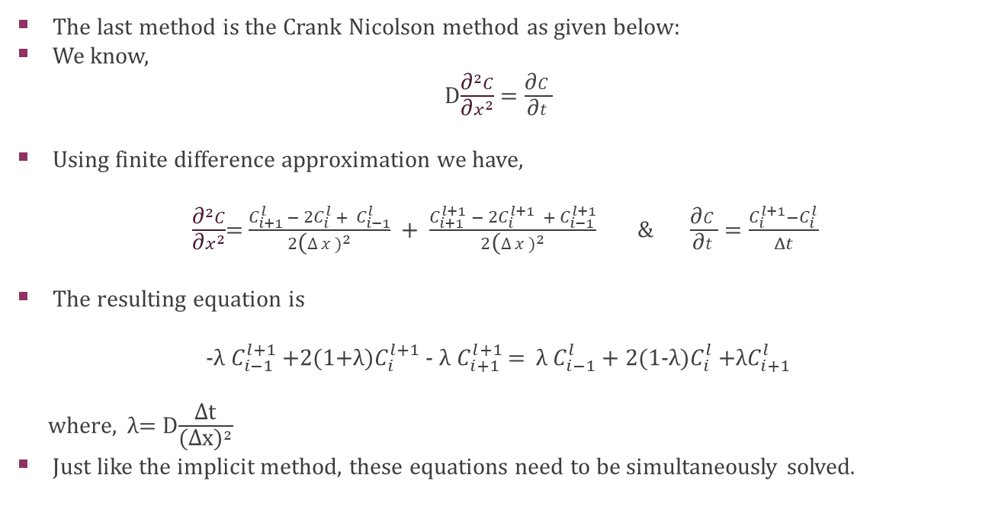
Crank Nicolson Method
The last method is the Crank Nicolson method as given below:
We know,
D$\frac{{\text{∂}}^{2}C}{\text{∂}x^{2}}=\frac{\text{∂}C}{\text{∂}t}$
Using finite difference approximation we have,
$\frac{{\text{∂}}^{2}C}{\text{∂}x^{2}}$= $\frac{C_{i+1 }^{l}− 2C_{i}^{l} +{ C}_{i−1}^{l}}{2{\text{(}Δx)}^{2}} + \frac{C_{i+1 }^{l+1} − 2C_{i}^{l+1} {+ C}_{i−1}^{l+1}}{2{\text{(}Δx)}^{2}}$ & $\frac{\text{∂}C}{\text{∂}t}=\frac{C_{i}^{l+1}−C_{i}^{l} }{Δt}$
The resulting equation is
-λ $C_{i−1}^{l+1}$+2(1+λ)$C_{i}^{l+1}$- λ $C_{i+1}^{l+1}$ = λ $C_{i−1}^{l}$+ 2(1-λ)$C_{i}^{l}$ $+\text{λ}C_{i+1}^{l}$
where, λ= D$\frac{\text{Δ}\text{t}}{{\text{(}\text{Δx}\text{)}}^{2}}$
Just like the implicit method, these equations need to be simultaneously solved.

Slide 8

Results
The equations obtained above have been used in our code in order to obtain the concentration profile. We have displayed the last ten temporal points for the complete section of the rod in a tabular format as the excel sheet was very large for the entire analysis.
However, we have provided the link to the analysis values and the entire code for reference here: https://github.com/arsh-k/Transient-Diffusion-Analysis
For all three methods, two curves were plotted and are shown in the slides. One on the left shows the concentration profile of the last 25 temporal points and the graph on the right shows the concentration profile at the end of the entire process. We only plotted 25 temporal points since the graph was difficult to understand if we had plotted more curves.
The following values have been used for the forthcoming slides:
$∆t=720 s , ∆x=0.0025$ m, D = 3.4 * ${10}^{−9} m^{2}/s$
$λ=0.39168$

Slide 9
Solution for Explicit Method
Index | 40 | 41 | 42 | 43 | 44 | 45 | 46 | 47 | 48 | 49 | 50
1 | 0.8734 | 0.8749 | 0.8763 | 0.8777 | 0.8791 | 0.8804 | 0.8817 | 0.8829 | 0.8841 | 0.8853 | 0.8864
2 | 0.7506 | 0.7535 | 0.7563 | 0.759 | 0.7616 | 0.7641 | 0.7665 | 0.7689 | 0.7712 | 0.7734 | 0.7756
3 | 0.6352 | 0.6392 | 0.6431 | 0.6468 | 0.6505 | 0.654 | 0.6574 | 0.6607 | 0.6639 | 0.667 | 0.6701
4 | 0.53 | 0.5348 | 0.5394 | 0.544 | 0.5483 | 0.5526 | 0.5567 | 0.5607 | 0.5646 | 0.5684 | 0.5721
5 | 0.4371 | 0.4423 | 0.4473 | 0.4523 | 0.4571 | 0.4617 | 0.4663 | 0.4707 | 0.475 | 0.4793 | 0.4834
6 | 0.3574 | 0.3627 | 0.3678 | 0.3728 | 0.3777 | 0.3825 | 0.3872 | 0.3918 | 0.3962 | 0.4006 | 0.4049
7 | 0.2912 | 0.2962 | 0.3011 | 0.3059 | 0.3106 | 0.3152 | 0.3198 | 0.3242 | 0.3286 | 0.3329 | 0.3371
8 | 0.2377 | 0.2422 | 0.2466 | 0.251 | 0.2553 | 0.2596 | 0.2638 | 0.2679 | 0.272 | 0.276 | 0.2799
9 | 0.1957 | 0.1995 | 0.2033 | 0.2071 | 0.2109 | 0.2146 | 0.2183 | 0.2219 | 0.2256 | 0.2291 | 0.2327
10 | 0.1635 | 0.1666 | 0.1697 | 0.1728 | 0.1759 | 0.179 | 0.1821 | 0.1852 | 0.1883 | 0.1914 | 0.1944
11 | 0.1392 | 0.1416 | 0.144 | 0.1465 | 0.1489 | 0.1514 | 0.1539 | 0.1564 | 0.1589 | 0.1614 | 0.1639
12 | 0.1211 | 0.1228 | 0.1246 | 0.1264 | 0.1282 | 0.1301 | 0.132 | 0.1339 | 0.1358 | 0.1378 | 0.1398
13 | 0.1073 | 0.1085 | 0.1097 | 0.111 | 0.1123 | 0.1136 | 0.115 | 0.1164 | 0.1178 | 0.1193 | 0.1208
14 | 0.0966 | 0.0973 | 0.098 | 0.0989 | 0.0997 | 0.1006 | 0.1015 | 0.1025 | 0.1035 | 0.1046 | 0.1056
15 | 0.0876 | 0.088 | 0.0884 | 0.0889 | 0.0894 | 0.09 | 0.0906 | 0.0912 | 0.0919 | 0.0926 | 0.0933
16 | 0.0797 | 0.0799 | 0.0801 | 0.0803 | 0.0806 | 0.0809 | 0.0813 | 0.0816 | 0.082 | 0.0825 | 0.083
17 | 0.0722 | 0.0722 | 0.0723 | 0.0724 | 0.0726 | 0.0727 | 0.0729 | 0.0731 | 0.0733 | 0.0736 | 0.0739
18 | 0.0648 | 0.0648 | 0.0648 | 0.0649 | 0.0649 | 0.065 | 0.0651 | 0.0652 | 0.0653 | 0.0654 | 0.0656
19 | 0.0574 | 0.0574 | 0.0574 | 0.0574 | 0.0574 | 0.0574 | 0.0575 | 0.0575 | 0.0576 | 0.0576 | 0.0577

Slide 10
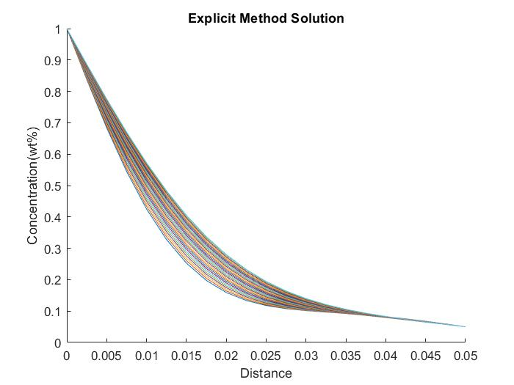
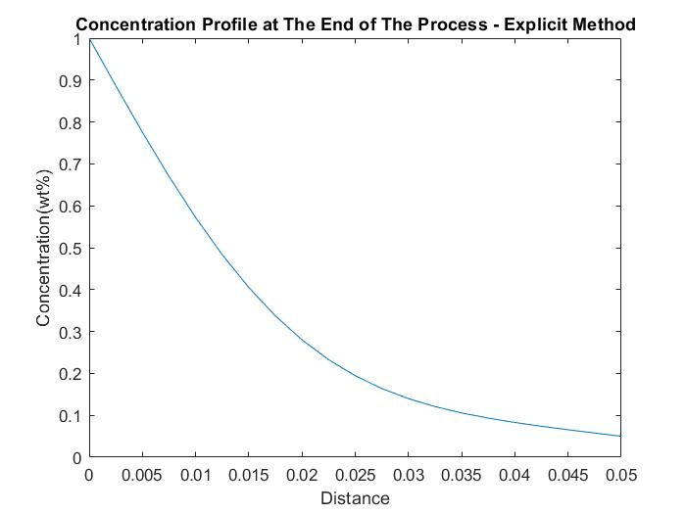

Slide 11
Solution for Implicit Method
index | 40 | 41 | 42 | 43 | 44 | 45 | 46 | 47 | 48 | 49 | 50
1 | 0.871002 | 0.872596 | 0.874132 | 0.875613 | 0.877042 | 0.878422 | 0.879757 | 0.881047 | 0.882296 | 0.883506 | 0.884678
2 | 0.746233 | 0.749262 | 0.752185 | 0.755007 | 0.757733 | 0.760369 | 0.76292 | 0.765389 | 0.767781 | 0.770101 | 0.77235
3 | 0.629489 | 0.633664 | 0.6377 | 0.641605 | 0.645384 | 0.649046 | 0.652594 | 0.656035 | 0.659375 | 0.662617 | 0.665766
4 | 0.52378 | 0.528726 | 0.533521 | 0.538172 | 0.542686 | 0.547069 | 0.551328 | 0.555468 | 0.559493 | 0.56341 | 0.567222
5 | 0.431103 | 0.436414 | 0.441582 | 0.446613 | 0.451512 | 0.456284 | 0.460935 | 0.465469 | 0.46989 | 0.474203 | 0.478411
6 | 0.352366 | 0.357662 | 0.362839 | 0.367899 | 0.372846 | 0.377684 | 0.382415 | 0.387044 | 0.391574 | 0.396006 | 0.400345
7 | 0.287466 | 0.292432 | 0.29731 | 0.302103 | 0.30681 | 0.311434 | 0.315977 | 0.320439 | 0.324822 | 0.329127 | 0.333357
8 | 0.23547 | 0.23988 | 0.244237 | 0.248542 | 0.252794 | 0.256991 | 0.261135 | 0.265224 | 0.26926 | 0.273241 | 0.277169
9 | 0.194863 | 0.198587 | 0.202291 | 0.205973 | 0.209632 | 0.213265 | 0.216872 | 0.220451 | 0.224001 | 0.227521 | 0.23101
10 | 0.163807 | 0.1668 | 0.1698 | 0.172805 | 0.17581 | 0.178815 | 0.181817 | 0.184815 | 0.187805 | 0.190787 | 0.19376
11 | 0.140368 | 0.142656 | 0.14497 | 0.147306 | 0.149663 | 0.152038 | 0.154428 | 0.156831 | 0.159245 | 0.161668 | 0.164098
12 | 0.122698 | 0.124354 | 0.126047 | 0.127774 | 0.129533 | 0.131323 | 0.133139 | 0.134982 | 0.136848 | 0.138735 | 0.140642
13 | 0.109155 | 0.110279 | 0.111445 | 0.112651 | 0.113895 | 0.115175 | 0.11649 | 0.117837 | 0.119214 | 0.12062 | 0.122054
14 | 0.098371 | 0.099075 | 0.099821 | 0.100608 | 0.101433 | 0.102296 | 0.103196 | 0.10413 | 0.105097 | 0.106096 | 0.107126
15 | 0.089275 | 0.08967 | 0.090102 | 0.090572 | 0.091079 | 0.091621 | 0.092198 | 0.092808 | 0.09345 | 0.094124 | 0.094827
16 | 0.081086 | 0.08127 | 0.081488 | 0.081737 | 0.082018 | 0.08233 | 0.082672 | 0.083043 | 0.083443 | 0.083871 | 0.084325
17 | 0.073282 | 0.073342 | 0.073428 | 0.073539 | 0.073675 | 0.073835 | 0.074019 | 0.074226 | 0.074457 | 0.07471 | 0.074984
18 | 0.065565 | 0.065567 | 0.065587 | 0.065624 | 0.065678 | 0.065748 | 0.065836 | 0.065939 | 0.066059 | 0.066194 | 0.066345
19 | 0.057808 | 0.057797 | 0.057796 | 0.057803 | 0.057819 | 0.057843 | 0.057876 | 0.057917 | 0.057966 | 0.058024 | 0.058089

Slide 12
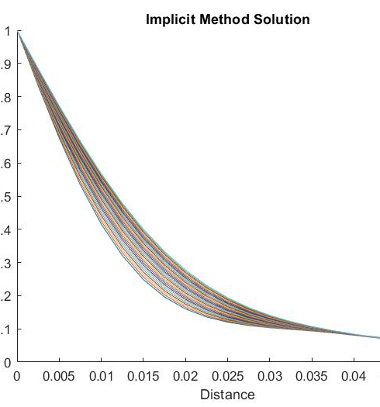
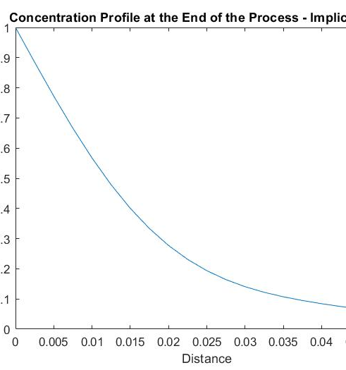

Slide 13
Solution for Crank Nicholson Method
index | 40 | 41 | 42 | 43 | 44 | 45 | 46 | 47 | 48 | 49 | 50
1 | 0.872214 | 0.873764 | 0.875259 | 0.876702 | 0.878094 | 0.87944 | 0.880742 | 0.882001 | 0.883221 | 0.884403 | 0.885549
2 | 0.74846 | 0.751414 | 0.754266 | 0.75702 | 0.759683 | 0.762258 | 0.764751 | 0.767166 | 0.769507 | 0.771776 | 0.773979
3 | 0.632384 | 0.636472 | 0.640425 | 0.644251 | 0.647955 | 0.651544 | 0.655024 | 0.658399 | 0.661675 | 0.664857 | 0.667949
4 | 0.526922 | 0.53179 | 0.53651 | 0.541089 | 0.545533 | 0.54985 | 0.554043 | 0.55812 | 0.562085 | 0.565943 | 0.569699
5 | 0.434083 | 0.439343 | 0.444461 | 0.449442 | 0.454291 | 0.459015 | 0.463617 | 0.468104 | 0.472478 | 0.476746 | 0.480909
6 | 0.35486 | 0.36014 | 0.365299 | 0.37034 | 0.375267 | 0.380082 | 0.384791 | 0.389396 | 0.393901 | 0.398308 | 0.402621
7 | 0.289277 | 0.294262 | 0.299155 | 0.30396 | 0.308676 | 0.313306 | 0.317852 | 0.322315 | 0.326698 | 0.331001 | 0.335227
8 | 0.236538 | 0.240992 | 0.245391 | 0.249732 | 0.254016 | 0.258243 | 0.262412 | 0.266525 | 0.270581 | 0.274581 | 0.278525
9 | 0.195244 | 0.199025 | 0.202782 | 0.206515 | 0.210221 | 0.213898 | 0.217546 | 0.221163 | 0.224748 | 0.228301 | 0.231821
10 | 0.163631 | 0.166681 | 0.169737 | 0.172794 | 0.175851 | 0.178905 | 0.181953 | 0.184995 | 0.188028 | 0.191051 | 0.194062
11 | 0.139799 | 0.142135 | 0.144496 | 0.14688 | 0.149283 | 0.151703 | 0.154137 | 0.156583 | 0.159039 | 0.161504 | 0.163974
12 | 0.121897 | 0.123587 | 0.125315 | 0.127078 | 0.128873 | 0.130699 | 0.132552 | 0.134431 | 0.136333 | 0.138257 | 0.1402
13 | 0.10826 | 0.109404 | 0.110591 | 0.111819 | 0.113087 | 0.114393 | 0.115733 | 0.117107 | 0.118512 | 0.119947 | 0.12141
14 | 0.097486 | 0.098197 | 0.098952 | 0.099749 | 0.100588 | 0.101465 | 0.102381 | 0.103332 | 0.104318 | 0.105337 | 0.106388
15 | 0.088469 | 0.088862 | 0.089296 | 0.089768 | 0.090279 | 0.090828 | 0.091412 | 0.092031 | 0.092684 | 0.09337 | 0.094087
16 | 0.080404 | 0.080583 | 0.080797 | 0.081044 | 0.081324 | 0.081637 | 0.081981 | 0.082356 | 0.08276 | 0.083194 | 0.083656
17 | 0.072752 | 0.072806 | 0.072887 | 0.072994 | 0.073126 | 0.073285 | 0.073468 | 0.073676 | 0.073907 | 0.074162 | 0.07444
18 | 0.065204 | 0.065201 | 0.065216 | 0.065249 | 0.0653 | 0.065369 | 0.065454 | 0.065557 | 0.065676 | 0.065812 | 0.065963
19 | 0.057625 | 0.057612 | 0.057607 | 0.057612 | 0.057627 | 0.057649 | 0.057681 | 0.057721 | 0.05777 | 0.057828 | 0.057893

Slide 14
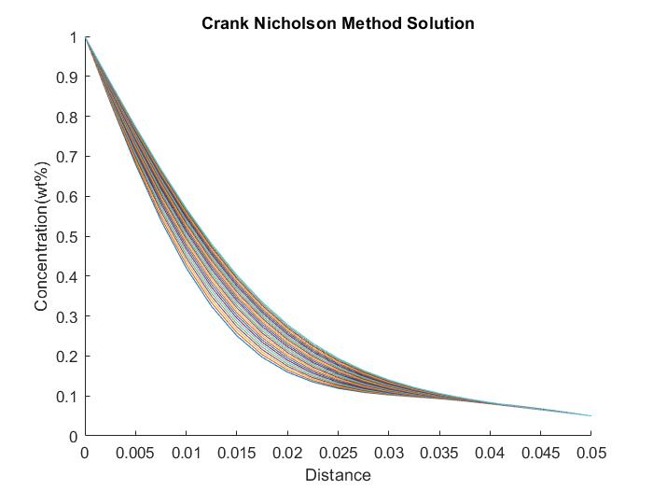
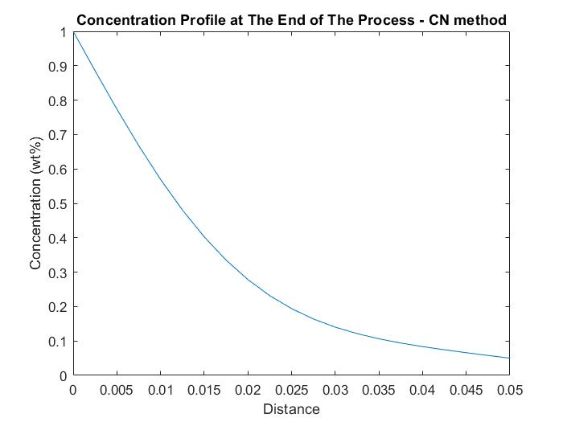

Slide 15

Comparison of the three methods
This table shows a brief summary of our findings for different values of λ.
The values used in this table are at t = 600 minutes and x = 0.045 m i.e., the 50th temporal point and the 19th spatial point.
λ must be less than 0.5 for explicit method owing to stability issues. Explicit method gives absurd values for λ $≥0.5$ as shown in the table. Implicit and Crank Nicolson method solution values remain almost same irrespective of the λ value.
Δt | λ | Explicit Method | Implicit Method | Crank Nicolson Method
600 | 0.3264 | 0.057722 | 0.0580572 | 0.05789313
720 | 0.3917 | 0.0577 | 0.05808907 | 0.057893
900 | 0.4896 | 0.057623 | 0.0581364 | 0.0578925
1200 | 0.6528 | 113.03817 | 0.0582141 | 0.057892
1800 | 0.9792 | 377443.5485 | 0.0583652 | 0.05788912

Slide 16
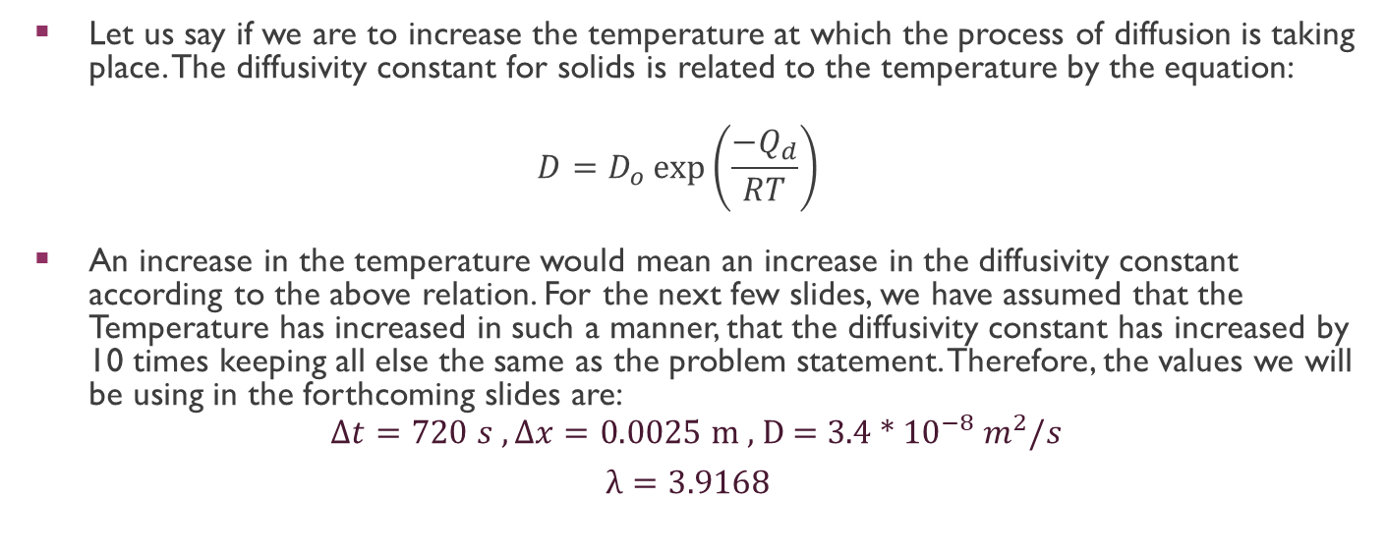
analysis at higher diffusivity values
Let us say if we are to increase the temperature at which the process of diffusion is taking place. The diffusivity constant for solids is related to the temperature by the equation:
$$D=D_{o}\exp\left(\frac{−Q_{d}}{RT}\right)$$
An increase in the temperature would mean an increase in the diffusivity constant according to the above relation. For the next few slides, we have assumed that the Temperature has increased in such a manner, that the diffusivity constant has increased by 10 times keeping all else the same as the problem statement. Therefore, the values we will be using in the forthcoming slides are:
$∆t=720 s , ∆x=0.0025$ m , D = 3.4 * ${10}^{−8} m^{2}/s$
$λ=3.9168$

Slide 17
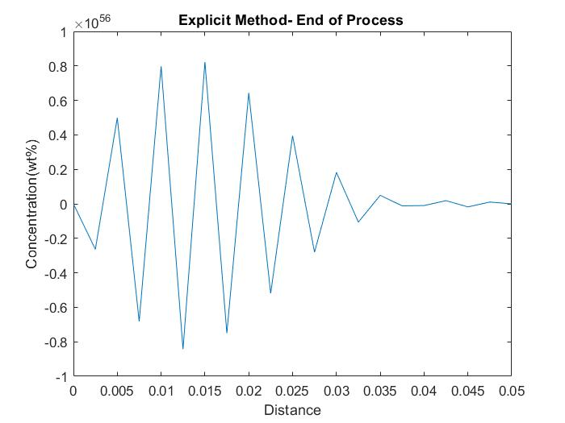
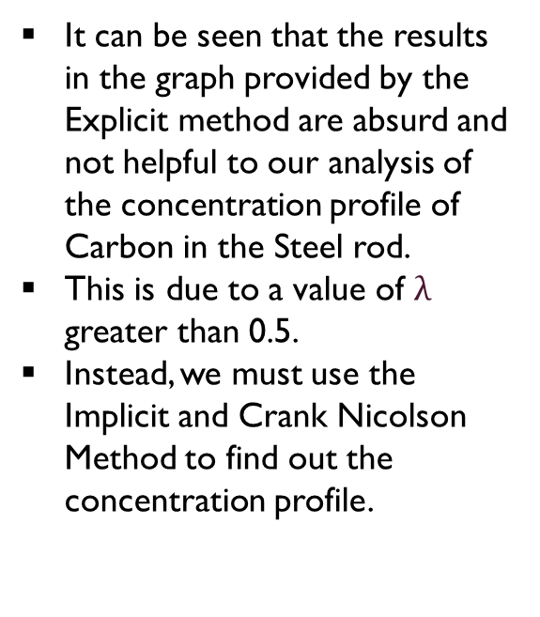
explicit METHOD - instability
It can be seen that the results in the graph provided by the Explicit method are absurd and not helpful to our analysis of the concentration profile of Carbon in the Steel rod.
This is due to a value of $λ$ greater than 0.5.
Instead, we must use the Implicit and Crank Nicolson Method to find out the concentration profile.

Slide 18
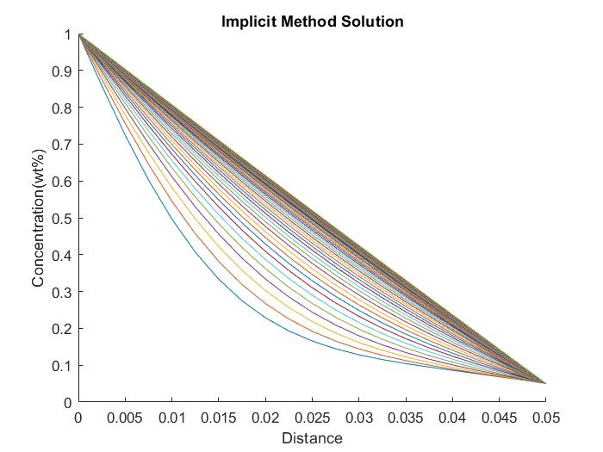
IMPLICIT METHOD
The Implicit Method shows that the process has reached a steady state towards the end. It can be clearly seen from the straight line that is obtained. This is because of the higher diffusivity value that causes it to reach the steady state.
Number of time divisions in this graph are 50.

Slide 19
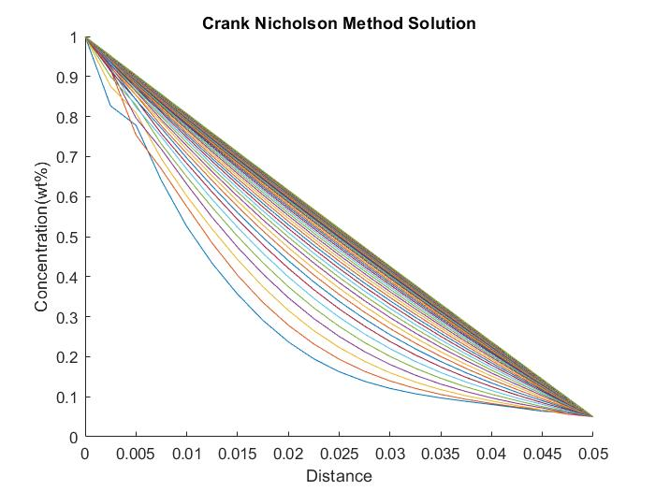
crank NICOLSON METHOD
The Crank Nicolson Method has a similar solution to that of the Implicit Method. Steady state has been achieved by the process owing to high diffusivity.
Number of time divisions in this graph are 50.

Slide 20
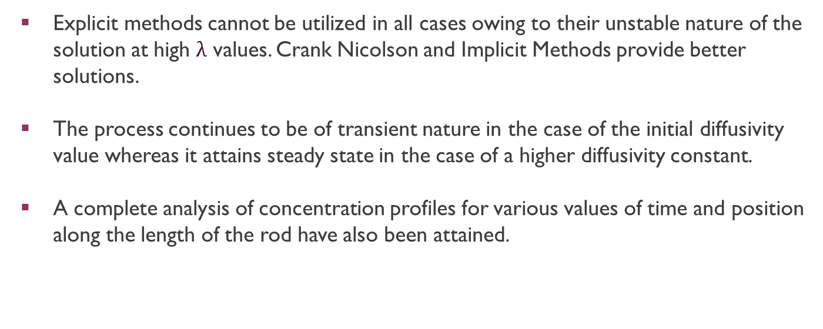
Conclusion
Explicit methods cannot be utilized in all cases owing to their unstable nature of the solution at high $λ$ values. Crank Nicolson and Implicit Methods provide better solutions.
The process continues to be of transient nature in the case of the initial diffusivity value whereas it attains steady state in the case of a higher diffusivity constant.
A complete analysis of concentration profiles for various values of time and position along the length of the rod have also been attained.

